Slide 1


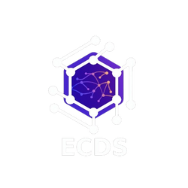

𝖣𝖠𝖳𝖠𝖲𝖤𝖳’25
ECDS
MED-I
TEAM NAME: Team name

Slide 2
𝖣𝖠𝖳𝖠𝖲𝖤𝖳’25
ECDS
Problem Statement:
Develop an AI Symptom Analysis Assistant that analyzes user-reported symptoms and suggests possible medical conditions with confidence indicators. The system aims to support early health awareness and informed decision-making, particularly in regions with limited access to medical professionals.
The solution should accept structured and unstructured symptom input, leverage medical datasets and APIs, and provide guideline-aware reasoning, risk-level classification, and explainable medical insights using AI and machine learning techniques.

Slide 3
𝖣𝖠𝖳𝖠𝖲𝖤𝖳’25
ECDS
SOLUTION:
MedAware is an AI-driven health assistant that combines
▸ Text-based symptom input
to allow users to enter symptoms in structured or unstructured form for analysis.
▸ Voice input with multilingual translation
to enable users to speak symptoms in their native language and have them accurately processed.
▸ Eye scanning using image-based ML
to detect visible health indicators through machine learning-based eye image analysis.
▸ Machine Learning disease prediction
to identify possible medical conditions with confidence scores based on extracted features.
▸ Gemini-powered reasoning & explanation
to provide explainable, guideline-aware medical insights in a user-friendly manner.
The system analyzes multiple health indicators and provides risk classification, confidence scores, and medical guidance without replacing professional diagnosis.

Slide 4
𝖣𝖠𝖳𝖠𝖲𝖤𝖳’25
ECDS
Innovation & Unique Selling Points:
1. Multilingual Voice-to-Symptom Input
Users can speak symptoms in their native language, which are automatically converted, translated, and analyzed by the system.
2. Eye Scan-Based Health Indicator Detection
The system uses image processing and machine learning to analyze eye features such as redness, yellowing, swelling, and abnormal patterns linked to health conditions.
3. Multimodal AI Fusion
Text symptoms, voice inputs, and visual eye data are combined to improve prediction accuracy and reliability.
4. Gemini AI-Powered Medical Reasoning
Gemini AI supports symptom understanding, medical explanation, risk reasoning, and user-friendly response generation.

Slide 5
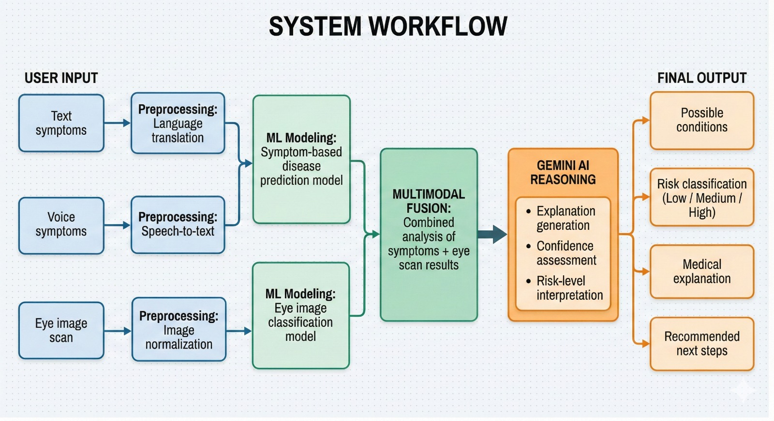
𝖣𝖠𝖳𝖠𝖲𝖤𝖳’25
ECDS
System Workflow
User Input
  Text symptoms
  Voice symptoms
  Eye image scan
Preprocessing
  Speech-to-text
  Language translation
  Image normalization
ML Modeling
  Symptom-based disease prediction model
  Eye image classification model
Multimodal Fusion
  Combined analysis of symptoms + eye scan results
Gemini AI Reasoning
  Explanation generation
  Confidence assessment
  Risk-level interpretation
Final Output
  Possible conditions
  Risk classification (Low / Medium / High)
  Medical explanation
  Recommended next steps

Slide 6
𝖣𝖠𝖳𝖠𝖲𝖤𝖳’25
ECDS
Machine Learning Approach
Symptom Analysis Model
Extracted symptoms are used to predict probable diseases with confidence scores.
Eye Scan Model
Eye images are analyzed to detect visual indicators associated with health conditions.
Fusion Layer
Outputs from both models are combined to improve reliability and reduce false positives.

Slide 7
𝖣𝖠𝖳𝖠𝖲𝖤𝖳’25
ECDS
Ethical Considerations
The system is designed as a decision-support tool and is not intended to replace professional medical diagnosis.
Clear disclaimers are provided to ensure responsible usage.
User data privacy and consent are strictly maintained.
The solution supports healthcare decision-making while respecting medical ethics.

Slide 8
𝖣𝖠𝖳𝖠𝖲𝖤𝖳’25
ECDS
Impact
The system improves healthcare accessibility for non-English speakers.
Early detection is supported through visual and symptom-based analysis.
Rural and under-served populations benefit from AI-assisted medical guidance.
Risk categorization helps reduce unnecessary panic.
Timely medical consultation is encouraged through clear risk assessment.

Slide 9
𝖣𝖠𝖳𝖠𝖲𝖤𝖳’25
ECDS
Demo Walkthrough
The user speaks symptoms in their native language.
Voice input is converted into translated text.
The user scans their eye using the device camera.
ML models analyze both symptom data and eye images.
Gemini AI generates a medical explanation.
The final risk assessment is displayed to the user.

Slide 10
𝖣𝖠𝖳𝖠𝖲𝖤𝖳’25
ECDS
TEAM MEMBERS:
Name: Nishanth.A.A
Reg No: 25BYB1080
Name: S.Haridev
Reg No: 25BYB1165
Name: J.Mohamed Arif
Reg No: 25BYB1146
Name: Hima Sri
Reg No: 25BAI1501
Name: M.K.keerthivasan
Reg No: 25Brs1304

